Slide 1

LIBRARY MANAGEMENT SYSTEM

Slide 2

Abstract
Technology Stack
Core Functionalities
Features
Frontend built with HTML, backend powered by Django.
Book cataloging
Responsive web design
Membership handling
Django ORM and authentication
Borrow and return books
Comprehensive admin panel
Generate reports

Slide 3
Introduction
The Library Management System (LMS) is designed to simplify and digitize everyday library operations. Built using HTML for the frontend and Django for the backend, it allows administrators to manage books, assign them to students, and track fines, while students can browse the catalog, borrow or return books, and view their fine details. This system aims to create an efficient, user-friendly, and transparent library experience for both users and administrators.
Admin Capabilities
Student Features
Add, update, delete books
Browse and search book catalog
Assign books to users
View and track fine history
Manage fines and penalties
Access user-friendly interface

Slide 4

Objectives
Efficient Book Management
Streamlined Book Assignment
Transparent Fine Management
Accessible Book Browsing
Clear Fine Information

Slide 5





Functional Requirements
Book Management
User Management
Borrowing/
Maintain catalog, update book records
Handle memberships and roles
Returning
Track loans and book returns efficiently
Fine Management
Reporting
Calculate and manage penalties
Generate usage and issue reports

Slide 6
Non-Functional Requirements
Performance & Reliability
Usability
Security & Scalability
Maintainability
Intuitive interface for admins and users
Simple updates and bug fixes
Fast response times and uptime guarantee
Protect data, support growing user base

Slide 7
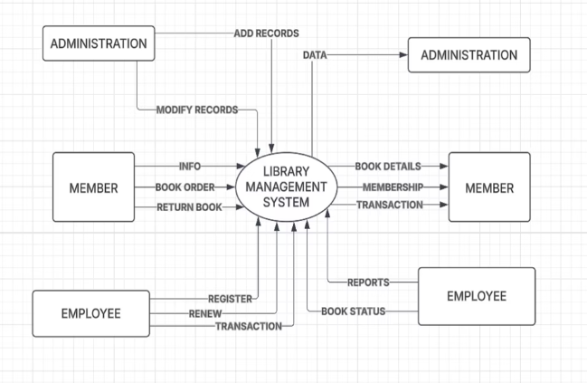
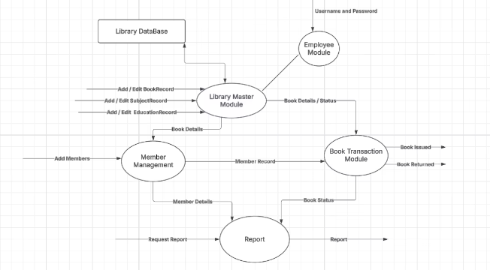
DFD Diagram
Level - I
Level - O
The Level 1 DFD breaks down the main system into sub-processes that show more detailed functionality.
The Level 0 DFD provides a high-level overview of the entire Library Management System as a single process. It illustrates how the system interacts with external entities such as Admin and Student.

Slide 8
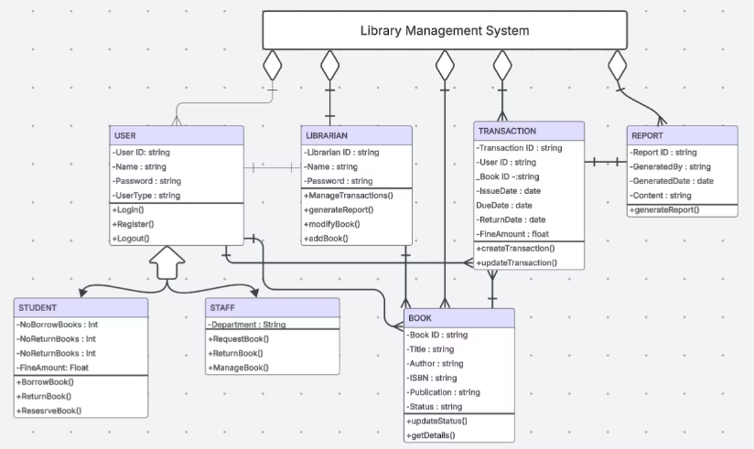
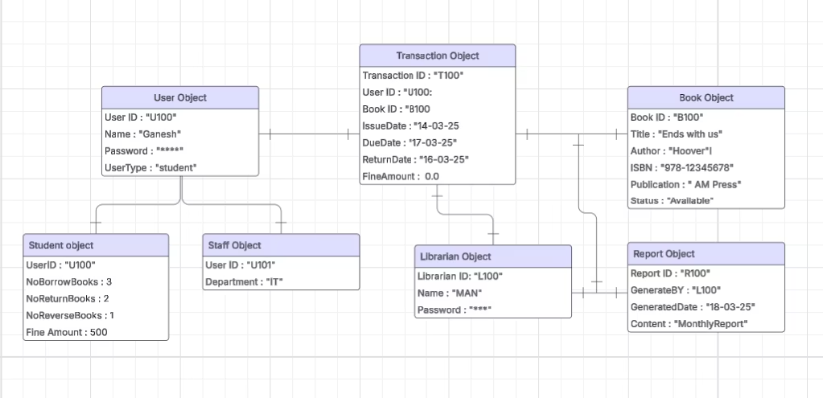
Class & Object Diagrams
Object Diagram
Class Diagram
The object diagram provides a snapshot of the system at a specific point in time, representing real-world instances of the classes defined in the class diagram.
The class diagram represents the static structure of the Library Management System by showcasing the key classes, their attributes, methods, and the relationships among them.

Slide 9
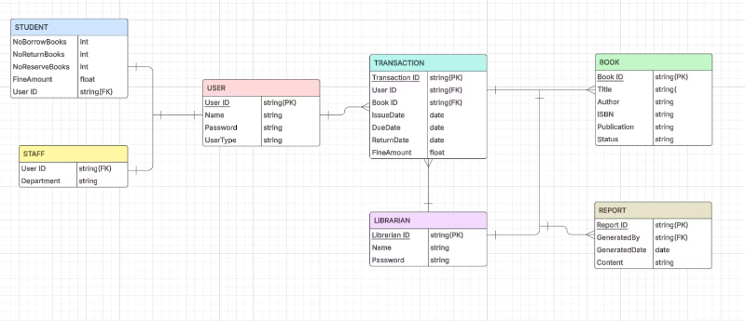
ER Diagram
The Entity-Relationship (ER) Diagram illustrates the logical structure of the database used in the Library Management System. It defines the entities, their attributes, and the relationships between them.

Slide 10
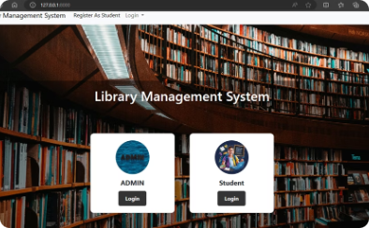
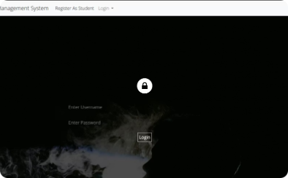
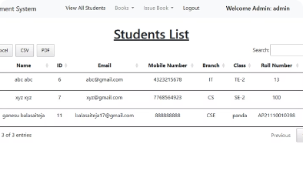
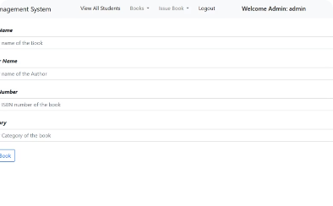
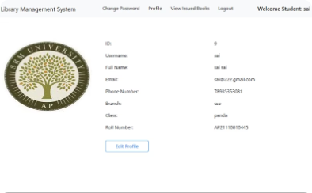
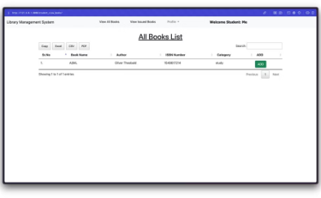
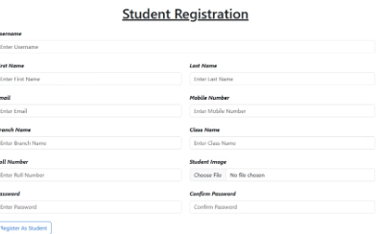
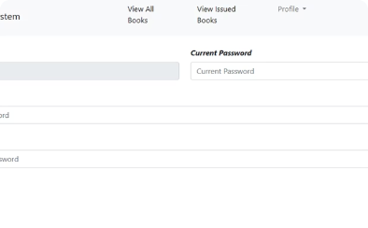
User Interface Snapshots
Home Page
Admin Login
Admin Dashboard
Add Books
Student Profile Edit
Books List Display
Student Registration
Password Change

Slide 11

Conclusion
Efficient and User-Friendly
Promotes Library Responsibility
Module supporting both admins and students
Encourages timely returns and fine transparency
Secure and Scalable
Maintainable System
Built for growth and data protection
Easy to update and manage

Slide 12

References
GeeksforGeeks
IITMS.co.in
Google Drive document link

